Slide 1
Lecture 1: Introduction to Economics

Slide 2
Economics and its Importance in Value Chain Agriculture
The management of society’s resources is important because resources are scarce.
Scarcity means that society has limited resources and therefore cannot produce all the goods and services people wish to have.
Economics is the study of how society manages its scarce resources.
Economics, in the context of value chain agriculture, can be defined as the study of how individuals, businesses, and governments make choices regarding resource utilization, production, distribution, and consumption of agricultural goods and services.

Slide 3
Economics and its Importance in Value Chain Agriculture
As future professionals in the value chain agriculture domain, an understanding of economics is essential in formulating strategies that foster sustainable agricultural practices, enhance productivity, and improve livelihoods within rural communities.
Economic analysis equips value-chain agriculture students with the tools to identify and address various challenges faced by producers and consumers in the agricultural market.
By evaluating the impacts of supply and demand dynamics, students can discern how price changes affect agricultural outputs, consumer behavior, and market equilibrium.
This knowledge will enable them to make informed decisions to maximize profitability and promote overall economic welfare.

Slide 4
The distinction between Microeconomics and Macroeconomics
In the study of economics, students encounter two key branches of economics: microeconomics and macroeconomics.
Microeconomics explores the behavior of individual economic agents, including farmers, agribusinesses, and consumers.
It seeks to explain the decision-making process at the grassroots level, helping students understand the factors that influence crop selection, input choices, and production levels.

Slide 5
The distinction between Microeconomics and Macroeconomics
Additionally, microeconomics analyzes market structures and the role of price mechanisms in transactions. e.g. agricultural transactions
Macroeconomics, on the other hand, focuses on the economy as a whole. It examines aggregate variables like national income, inflation, and unemployment.

Slide 6
Overview of Economic Principles

Slide 7
People Face Tradeoffs
The principle of tradeoffs underscores the inevitable reality of scarcity—limited resources against unlimited wants.
To get one item, individuals usually give up another item(s)
In personal and society contexts, tradeoffs force us to allocate resources wisely and make conscious choices that yield the greatest benefit.
Another trade-off society faces is between efficiency and equality.
Efficiency means that society is getting the maximum benefits from its scarce resources.
Equality means that those benefits are distributed uniformly among society’s members.
Efficiency refers to the size of the economic pie, and equality emphasizes on how the pie is divided into individual slices.

Slide 8
The Cost of Something Is What You Give Up to Get It (Opportunity cost)
Opportunity cost is forgone cost- what we give up to obtain something else.
The concept of opportunity cost reveals the hidden costs of decisions.
Recognizing opportunity costs enhances decision making by revealing the full array of choices and their consequences.
Economic profit = accounting profit – opportunity cost

Slide 9
Rational People Think at the Margin:
Rational people are individuals who systematically and purposefully do the best they can to achieve their objectives.
Rational decisionmakers weigh the additional benefits and costs of incremental changes(marginal changes).
This principle guides us in optimizing decisions by considering the incremental impact of each step.

Slide 10
People Respond to Incentives:
Incentives are rewards or penalties that influence behavior.
Incentives, both positive and negative, shape human behavior.
A deep understanding of incentives empowers us to predict and influence individual and collective actions.

Slide 11
Trade Can Make Everyone Better Off:
Trade allows each person to specialize in the activities he or she does best, whether it is farming, sewing, or home building.
By trading with others, people can buy a greater variety of goods and services at lower cost.
Countries as well as households benefit from the ability to trade with one another.
Trade allows countries to specialize in what they do best and to enjoy a greater variety of goods and services.
This concept is known as comparative advantage in economics Mutual gains from trade foster cooperation and specialization.

Slide 12
Markets Are Usually a Good Way to Organize Economic Activity:
Market interactions facilitate efficient resource allocation through supply and demand as postulated by Adam Smith- “the invisible hand”.
This type of economy is known as market economy or decentralized economy.
A market economy is an economy that allocates resources through the decentralized decisions of many firms and households as they interact in markets for goods and services
As opposed to central planner economy where economic activity (what to produce, how much was produced and who should it be produced for produce) is determined by the government with the ideology of promoting wellbeing of the economy as a whole i.e. communism

Slide 13
Governments Can Sometimes Improve Market Outcomes:
Government intervention can correct market failures, such as externalities and information asymmetry.
Effective governance enhances overall societal wellbeing by addressing market imperfections.
Government is a necessary entity in the system that enforces property rights.
Property rights is the ability to exercise control over scarce resources

Slide 14
A Country’s Standard of Living Depends on Its Ability to Produce Goods and Services
Economic prosperity hinges on productivity growth and technological advancement.
Productivity is the quantity of output produced from a single unit of labor.
Fostering an environment conducive to innovation and skill development elevates living standards.

Slide 15
Prices Rise When the Government Prints Too Much Money:
The principle of monetary responsibility warns against excessive money supply and resulting inflation.
‘Sound’ monetary policy safeguards the purchasing power of currency and maintains price stability.

Slide 16
Society Faces a Short Run Tradeoff between Inflation and Unemployment:
Short-Run Effects of Monetary Injections:
Increasing money supply stimulates overall spending and demand for goods/services. This creates a situation where there is plenty money chasing a few goods. e.g. Maize market recently
Higher demand encourages firms to hire more workers and increase production and this leads to lower unemployment.
This relationship is shown by the Phillips curve. It suggests that employment and inflation are inversely related.
Policymakers must navigate this delicate balance to achieve both economic stability and employment goals.

Slide 17
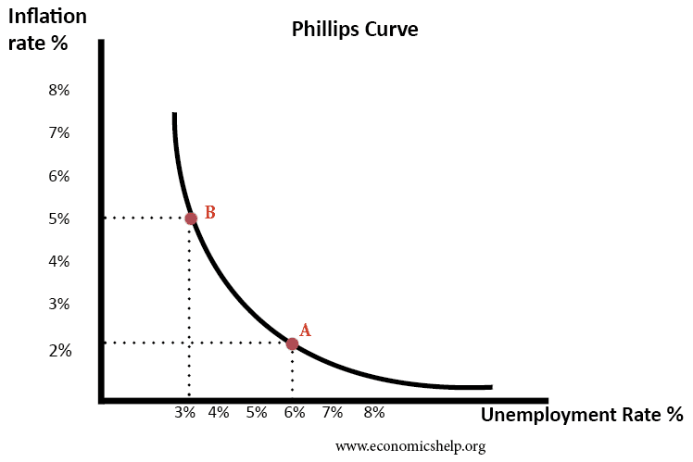

Slide 18
Application of Economic Thinking in Real-World Agricultural Challenges
The application of economic thinking is instrumental in resolving real-world challenges faced by agricultural producers and consumers:
Sustainable Agriculture: Economic analysis assists in evaluating the costs and benefits of adopting sustainable practices, guiding individuals to strike a balance between productivity and environmental conservation.
Agricultural Policy Formulation: Individuals learn to design policies that incentivize agricultural growth, enhance food security, and address income inequality in rural communities.
Technological Advancements: Economic thinking helps individuals assess the economic viability of adopting innovative technologies in value chain agriculture, such as precision agriculture and biotechnology.
Food Supply and Distribution: Individuals will explore the role of economics in analyzing food supply chains, addressing food shortages, and optimizing distribution networks to ensure food accessibility and affordability.

Slide 19
Economics forms the bedrock of understanding decision-making and resource allocation within value chain agriculture. Aspiring professionals in this domain benefit significantly from comprehending the principles of economics, distinguishing between microeconomics and macroeconomics, and applying economic thinking to address real-world challenges.
Armed with economic insights, value chain agriculture students can chart a sustainable path, optimize resource utilization, and contribute to transformative development within agricultural communities.
By leveraging economic principles, they become key players in driving positive change, promoting inclusive growth, and fostering resilience in the ever-evolving landscape of value chain agriculture.

Slide 20
Lecture 2: Market Forces: Demand and Supply

Slide 21
Demand and Supply in Value Chain Agriculture

Slide 22
Demand
Demand is the quantity of goods or services that consumers are willing and able to buy at different price levels during a specific period.
It represents the desire of buyers to obtain products in the market.
Law of demand
Other things held equal (ceteris paribus), when the price of a good rises, the quantity demanded of that particular good falls and when the price of the good falls, the quantity demanded of the good rises.

Slide 23
Supply
Supply, on the other hand, refers to the quantity of goods or services that producers are willing and able to offer for sale at various price levels during a specific period.
Supply reflects the willingness of producers to make their products available to the market.
Law of supply
Other things equal (ceteris paribus), when the price of a good rises, the quantity supplied of the good rises and when the price of the good falls, the quantity supplied of the good falls.

Slide 24
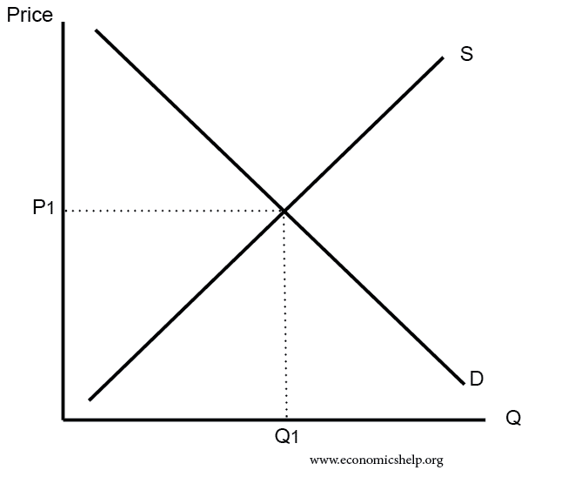
Diagram showing supply and demand schedule

Slide 25
Factors Influencing Demand
Price
A change in the price of products can directly affect the quantity demanded by consumers. When prices rise, demand tends to decrease, and vice versa. This causes a movement along the demand schedule.
Income
As consumers' income changes, their ability to purchase products also changes. Higher incomes often lead to increased demand for goods. This causes a shift in the demand schedule.
Preferences
Consumer preferences for specific products can greatly impact demand. Changes in taste and preferences may cause shifts in demand between different products.

Slide 26
Population:
An increase in population typically leads to higher demand for products.
Expectations:
Expectations of future price changes or income fluctuations can influence current demand. For example, if consumers anticipate higher prices in the future, they may increase their current demand.
Price of other goods
Substitutes- when the prices of substitutes of a good a rises, it leads to an increase in the quantity demanded of it’s close substitute.
Complements- when the prices of a good rises, the quantity demanded of its ‘perfect’ complement falls.

Slide 27
Factors Influencing Supply
Input Prices:
Changes in the prices of inputs like seeds, fertilizers, and labor can affect the cost of production, influencing the quantity of agricultural goods that producers are willing to supply
Technology:
Technological advancements in agriculture can increase productivity, leading to higher supply of agricultural products.
Government Policies:
Government policies, such as subsidies or trade regulations, can impact the cost of production and, consequently, the supply of agricultural goods.
Natural Conditions:
Weather conditions, pest outbreaks, and natural disasters can significantly influence the quantity of agricultural products available in the market.

Slide 28
Understanding Market Equilibrium

Slide 29
Market equilibrium is the point where the quantity demanded by consumers is equal to the quantity supplied by producers at a particular price level.
At this point, there is no surplus or shortage in the market.
When the price is too high (above the equilibrium), there is a surplus, leading to downward pressure on prices.
When the price is too low (below the equilibrium), there is a shortage, leading to upward pressure on prices.

Slide 30
Consumer Surplus and Producer Surplus
Consumer surplus refers to the economic benefit that consumers receive from purchasing a good or service at a price lower than the maximum price they were willing to pay.
In simpler terms, it represents the difference between the price a consumer actually pays and the highest price they would have been willing to pay.
Producer surplus, on the other hand, refers to the economic benefit that producers or firms receive from selling a good or service at a price higher than the minimum price they were willing to accept.
It represents the difference between the market price of a product and the lowest price a producer would have been willing to sell it for.

Slide 31
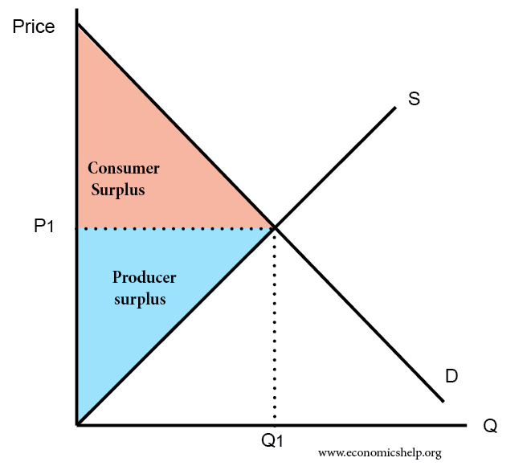
Graph showing Consumer and Producer Surplus

Slide 32
Consumer Surplus in Agriculture
Consumer surplus in agriculture refers to the benefit that consumers receive when purchasing agricultural products at a price lower than the maximum price they were willing to pay.
Consider a farmer's market selling fresh organic tomatoes. Suppose a consumer values a basket of organic tomatoes at MWK 200 because they highly appreciate the quality and health benefits of these tomatoes.
However, due to market competition or promotional discounts, the tomatoes are available for purchase at MWK 150.
In this case, the consumer surplus would be MWK 50 (MWK 200 – MWK 150), representing the extra value the consumer gains by acquiring the tomatoes at a price lower than their perceived worth.

Slide 33
Producer Surplus in Agriculture:
Producer surplus in agriculture refers to the benefit that farmers or agricultural producers receive when selling their products at a price higher than the minimum price they were willing to accept.
Consider a wheat farmer selling sacks of wheat in the market. Suppose the farmer incurs production costs and would be willing to sell a sack of wheat at MWK 80 to cover these costs and earn a reasonable profit.
However, due to the strong demand for high-quality wheat, the market price for a sack of wheat is MWK 120. In this scenario, the producer surplus would be MWK 40 (MWK 120 – MWK 80), reflecting the extra revenue or profit the farmer gains by selling the wheat at a price higher than their production cost or the minimum price they were willing to accept.

Slide 34
In both cases, consumer surplus and producer surplus play a crucial role in understanding the welfare and efficiency of agricultural markets.
Consumer surplus highlights the benefits that consumers enjoy when they can purchase products at prices lower than their valuation, while producer surplus emphasizes the benefits that farmers gain when they can sell their products at prices higher than their production costs.
These concepts help economists and policy makers evaluate market efficiency, welfare, and the overall economic impact of agricultural transactions.

Slide 35
Practical Examples of Demand and Supply in Agricultural Markets
Example 1:
Apple Market: During a bumper apple harvest, the supply of apples increases, leading to a surplus.
As a result, apple prices drop, and producers may find it challenging to sell their produce
Example 2:
Rice Market: If a government implements a subsidy program for rice farmers, the cost of production decreases, leading to an increase in the supply of rice in the market.

Slide 36
Implications of Demand and Supply in Agriculture
Understanding demand and supply helps value-chain agriculture students in:
Price Analysis: Analyze how changes in demand and supply affect agricultural prices and the income of producers
Market Strategies: Devise strategies to match production with consumer demand and maximize profits for farmers.
Policy Formulation: Evaluate the impact of government policies on agricultural markets and production.

Slide 37
Demand and supply are the driving forces behind agricultural markets. By comprehending these concepts, value chain agriculture students can better analyze market dynamics, make informed decisions, and address challenges in the agricultural sector.
As future professionals, mastering demand and supply will enable students to contribute significantly to the sustainable growth and development of value chain agriculture.

Slide 38
Exercise 1: Demand and Supply Analysis
Suppose the price of tomatoes in a local market increases due to a decrease in supply. What will be the likely impact on the quantity demanded by consumers? Explain your answer.
In a hypothetical scenario, the income of consumers in a rural area increases significantly. How will this change in income influence the demand for agricultural products in the region?
Draw a demand curve for oranges in a value chain agriculture market, indicating the relationship between price and quantity demanded. Explain the slope of the demand curve.

Slide 39
Exercise 2: Factors Influencing Supply
Analyze the impact of a drought on the supply of wheat in a value-chain agriculture market. How might farmers respond to the reduced supply?
Discuss how government policies, such as imposing export tariffs on agricultural products, can affect the supply of those products in the domestic market.
3. Provide examples of technological advancements in agriculture and explain how they can increase the supply of specific crops.

Slide 40
Case Study: The Impact of COVID-19 on the Poultry Industry
The poultry industry in Malawi faced significant challenges during the COVID-19 pandemic. Travel restrictions and lockdown measures disrupted the supply chain, affecting both producers and consumers.
Analyze the factors that influenced the demand for poultry products during the pandemic.
Discuss the supply-side challenges faced by poultry farmers during the COVID-19 crisis.
How did the disruption in demand and supply affect market equilibrium and poultry prices in the region?

Slide 41
The Market Equilibrium
In this session, we will explore the concept of market equilibrium and its significance in value-chain agriculture.
Market equilibrium represents the balance between demand and supply in a market, determining the price and quantity of goods exchanged.
Understanding market equilibrium is essential for value chain agriculture proffessionals as it helps in analyzing market dynamics and making informed decisions.

Slide 42
Lecture 3: Market Equilibrium

Slide 43
Balance of Demand and Supply
Market equilibrium signifies a balance between two opposing forces:
As defined in earlier sessions;
Demand:
The quantity of goods or services that consumers are willing and able to buy at a given price level.
Supply:
The quantity of goods or services that producers are willing and able to offer for sale at the same price level.

Slide 44
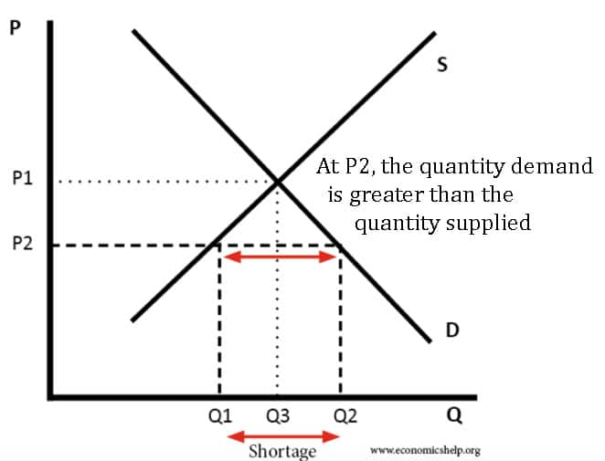
Excess Demand (Shortage)

Slide 45
Excess Supply (Surplus)
Excess supply, also known as a surplus, occurs when the quantity supplied by producers exceeds the quantity demanded by consumers at a specific price.
In this scenario, there is an oversupply of goods in the market, which can lead to downward pressure on prices.

Slide 46
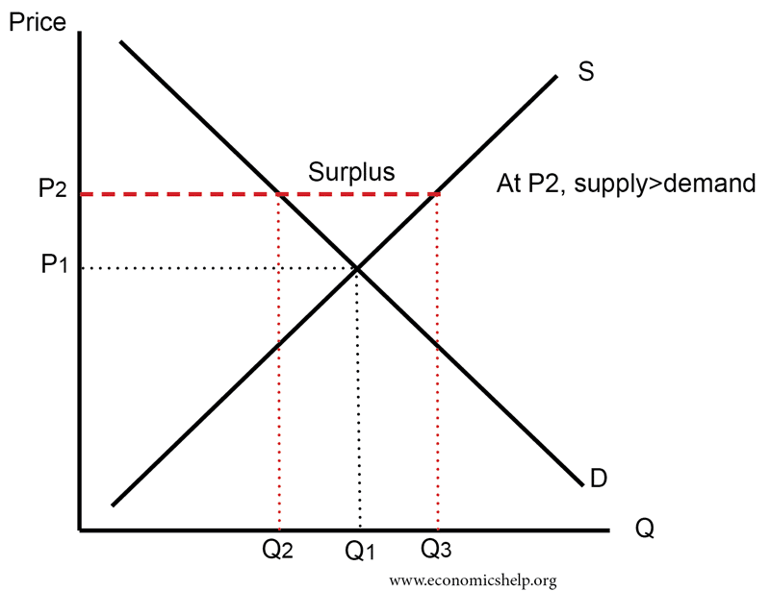
Excess Supply (Surplus)

Slide 47
Effects of Changes in Demand and Supply on Market Equilibrium
Changes in demand and supply can shift the market equilibrium, leading to new price and quantity levels.
Increase in Demand:
If demand increases, the demand curve shifts to the right, causing a new market equilibrium with a higher price and quantity.
Decrease in Demand:
If demand decreases, the demand curve shifts to the left, resulting in a new market equilibrium with a lower price and quantity.

Slide 48
Effects of Changes in Demand and Supply on Market Equilibrium
Increase in Supply:
If supply increases, the supply curve shifts to the right, leading to a new market equilibrium with a lower price and higher quantity.
Decrease in Supply:
If supply decreases, the supply curve shifts to the left, resulting in a new market equilibrium with a higher price and lower quantity.

Slide 49
Diagrammatic Representation of Market Equilibrium

Slide 50
Importance of Market Equilibrium in VCA
Understanding market equilibrium is crucial for value chain agriculture students because it:
Determines Prices: Market equilibrium determines the market price at which agricultural goods are bought and sold, impacting the income of producers and affordability for consumers.
Helps in Decision Making: Analyzing market equilibrium assists value chain actors in making informed decisions regarding production levels and resource allocation.
Balances Supply and Demand: Market equilibrium ensures that there is no surplus or shortage, fostering stability in the agricultural market.

Slide 51
Exercise: Market Equilibrium
Consider the market for tomatoes in Malawi. At a price of MK 200 per kilogram, the quantity demanded is 1,000 kilograms, and the quantity supplied is 800 kilograms. Is there a shortage or surplus in the market? If so, calculate the magnitude of the shortage or surplus.
Suppose the demand for maize increases due to an increase in population and consumer preferences. Explain how this change in demand would affect the market equilibrium in the maize industry. Draw a diagram to illustrate the new equilibrium price and quantity
The government implements a subsidy program to support small-scale dairy farmers. As a result, the supply of milk increases in the market. Describe the impact of this subsidy on the market equilibrium for dairy products. How would the equilibrium price and quantity change?
In the market for fish, the quantity demanded is given by the equation Qd = 500 - 2P, while the quantity supplied is given by the equation Qs = 100 + 3P, where P is the price per kilogram of fish. Determine the market equilibrium price and quantity of fish.

Slide 52
Case Study: The Market for Organic Vegetables
The market for organic vegetables in Malawi has been growing steadily due to increasing consumer awareness of health and environmental benefits. Organic vegetable producers face higher production costs due to the use of organic farming methods. At the same time, consumers are willing to pay a premium for organic produce.
Suppose the market for organic vegetables is initially in equilibrium, with a price of MK 500 per kilogram and a quantity of 2,000 kilograms sold per week. However, due to a surge in demand for organic vegetables, the quantity demanded increases to 2,500 kilograms at the same price
Analyze the impact of this increase in demand on the market equilibrium. Is there a shortage or surplus in the market? Calculate the magnitude of the shortage or surplus.
How might organic vegetable producers respond to this increase in demand? Discuss possible strategies they could adopt to meet the higher demand.
In the long run, if more farmers enter the organic vegetable market, how would this affect the market equilibrium? Consider both supply and demand factors.

Slide 53
Elasticity and Its Applications

Slide 54
Elasticity measures the responsiveness of quantity demanded and quantity supplied to changes in price, influencing pricing decisions, revenue management, and market dynamics.

Slide 55
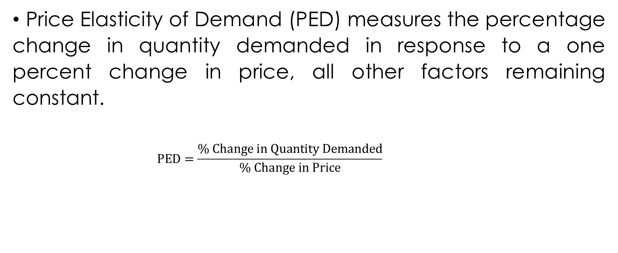
Price Elasticity of Demand (PED)
Price Elasticity of Demand (PED) measures the percentage change in quantity demanded in response to a one percent change in price, all other factors remaining constant.
$$PED=\frac{\% Change in Quantity Demanded}{\% Change in Price}$$

Slide 56
Interpretation of Price Elasticity Coefficients

Slide 57
Elastic Demand: PED > 1
Percentage change in quantity demanded is greater than the percentage change in price.
Consumers are responsive to price changes.
e.g. Luxury goods

Slide 58
Unitary Demand: PED = 1
Percentage change in quantity demanded is equal to the percentage change in price.
Total revenue remains constant when price changes.
e.g. Agricultural products with many substitutes.

Slide 59
Inelastic Demand: PED < 1
Percentage change in quantity demanded is less than the percentage change in price.
Consumers are less responsive to price changes.
e.g. Necessities, essential goods.

Slide 60

Calculating of Price Elasticity of Demand
To calculate PED,
$$PED=\frac{\% Change in Quantity Demanded}{\% Change in Price}$$

Slide 61
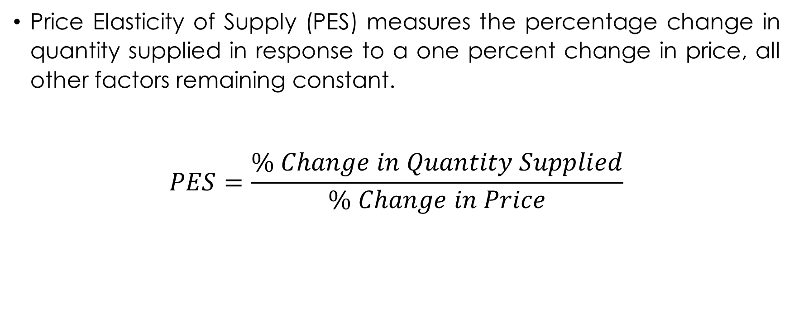
Price Elasticity of Supply (PES)
Price Elasticity of Supply (PES) measures the percentage change in quantity supplied in response to a one percent change in price, all other factors remaining constant.
$$PES=\frac{\% Change in Quantity Supplied}{\% Change in Price}$$

Slide 62
Interpretation of Price Elasticity of Supply Coefficients

Slide 63
Elastic supply: PES > 1
Producers are responsive to price changes.
Percentage change in quantity supplied is greater than the percentage change in price.
e.g. Agricultural products with short production periods

Slide 64
Unitary Elastic Supply: PES = 1
Percentage change in quantity supplied is equal to the percentage change in price.
e.g. Some raw materials.

Slide 65
Inelastic Supply: PES < 1
Producers are less responsive to price changes.
Percentage change in quantity supplied is less than the percentage change in price.
Agricultural products with long production periods.

Slide 66

Calculating of Price Elasticity of Supply
To calculate PES:
$$PES=\frac{\% Change in Quantity Supplied}{\% Change in Price}$$

Slide 67
Income Elasticity of Demand (XED)
Income elasticity of demand (YED) is a crucial concept in economics that measures how the quantity demanded of a product or service changes in response to changes in consumers' income levels.
It provides valuable insights into how sensitive consumer demand is to fluctuations in income.

Slide 68
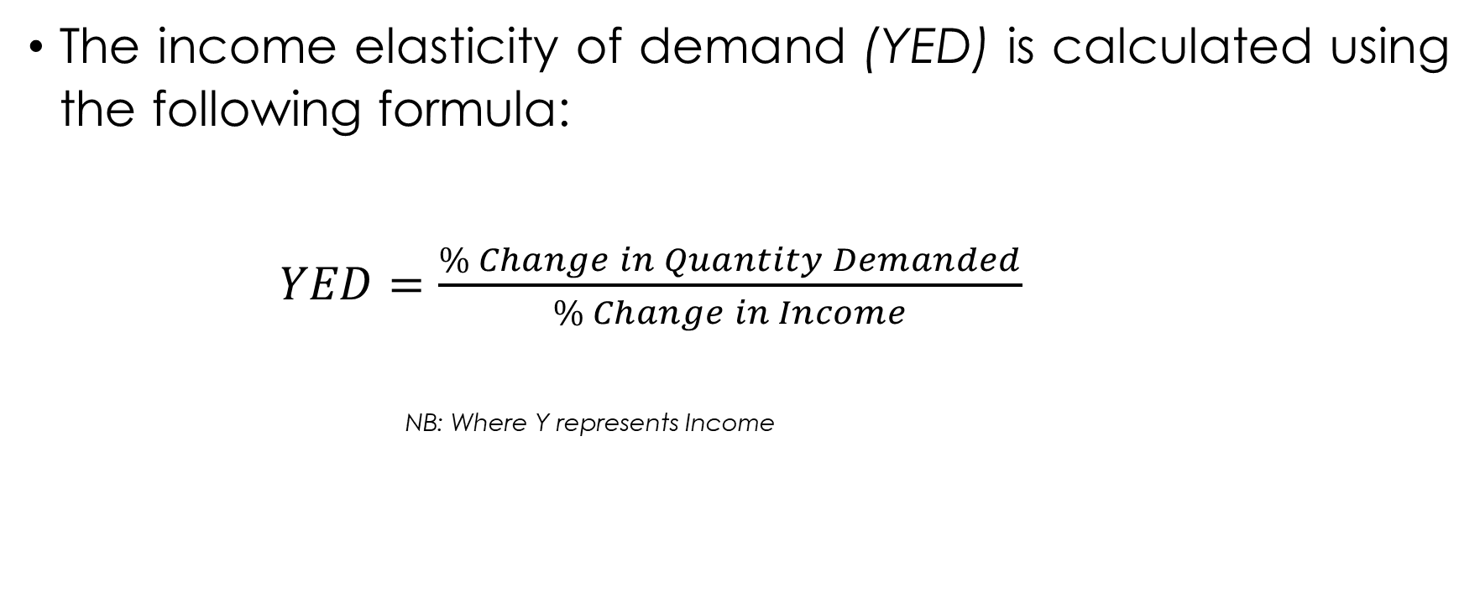
Calculating Income Elasticity of Demand:
The income elasticity of demand (YED) is calculated using the following formula:
$YED=\frac{\% Change in Quantity Demanded}{\% Change in Income}$
NB: Where Y represents Income

Slide 69
Interpreting Income Elasticity of Demand:
Positive Income Elasticity (YED > 0):
YED > 1: Indicates a luxury or superior good. As consumers' income increases, the demand for such products increases at a proportionally higher rate.
VCA need to recognize the importance of these goods in the market and explore opportunities to cater to consumers' changing preferences as income rises.
0<YED<1: Represents a necessity. As consumers' income increases, the demand for these goods also increases, but at a proportionally lower rate.
VCA professionals need to be aware of the significance of these goods for different income groups and identify potential shifts in demand patterns.

Slide 70
2. Negative Income Elasticity (YED < 0):
Indicates an inferior good. As consumers' income rises, the demand for such products decreases.
VCA students must recognize the impact of income changes on the demand for inferior goods and identify strategies to adapt to evolving consumer preferences.

Slide 71
3. Zero Income Elasticity (YED = 0):
Represents income-inelastic goods. The quantity demanded remains constant regardless of changes in income.
Individuals should be aware of the stability of demand for these goods, as it helps in planning and managing supply chains.

Slide 72
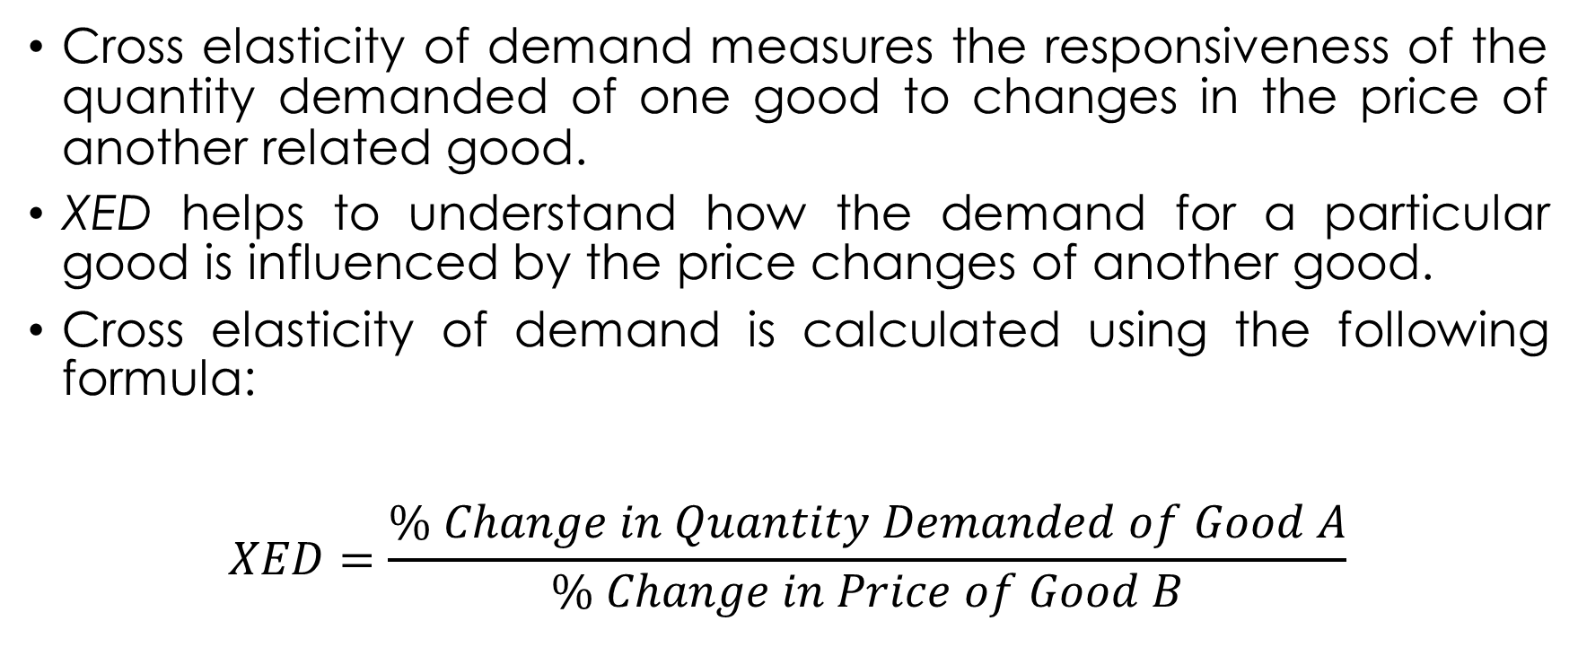
Cross Elasticity of Demand (XED)
Cross elasticity of demand measures the responsiveness of the quantity demanded of one good to changes in the price of another related good.
XED helps to understand how the demand for a particular good is influenced by the price changes of another good.
Cross elasticity of demand is calculated using the following formula:
$$XED=\frac{\% Change in Quantity Demanded of Good A}{\% Change in Price of Good B}$$

Slide 73
Interpretating cross elasticity
The cross elasticity of demand can be classified into three categories based on the sign of the value obtained:

Slide 74
1. Positive Cross Elasticity (Substitutes)
A positive cross elasticity of demand indicates that the two goods are substitutes for each other.
This implies that an increase in the price of one good leads to an increase in the quantity demanded of the other, and vice versa.
E.g. If the price of tea increases, the demand for coffee might also increase, as consumers switch to the cheaper alternative.

Slide 75
2. Negative Cross Elasticity(Complements)
A negative cross elasticity of demand suggests that the two goods are complements, meaning they are consumed together.
A negative cross elasticity means that an increase in the price of one good leads to a decrease in the quantity demanded of the other, and vice versa.
E.g. If the price of smartphones increases, the demand for smartphone cases might decrease, as fewer people would be willing to buy smartphones without protective cases.

Slide 76
3. Zero Cross Elasticity (Unrelated Goods)
If the cross elasticity of demand is zero, it indicates that the two goods are unrelated, and changes in the price of one good have no impact on the quantity demanded of the other.
Zero cross elasticity means that the goods are independent of each other, and consumers do not consider the price of one good when making choices about the other.
E.g. The demand for pens and ice cream is likely to be unrelated, as changes in the price of pens are unlikely to affect the demand for ice cream.

Slide 77
Elasticity's Role in Market Responsiveness
Elastic markets respond more quickly to price changes.
Inelastic markets are slower to respond, affecting market dynamics and competition.

Slide 78
Elasticity’s Role in Understanding Agent Behavior in VCA
Elasticity helps value chain agriculture stakeholders comprehend how changes in prices impact demand for agricultural products.
Producers can adjust production based on price elasticity to optimize revenue

Slide 79
Practical Exercises

Slide 80
Exercise 1: Calculating Price Elasticity of Demand (PED)
Suppose the quantity demanded for maize in a local market change from 1000 kg to 1200 kg when the price decreases from MK 10 per kg to MK 8 per kg. Calculate the price elasticity of demand (PED) for maize.

Slide 81
Exercise 2: Calculating Price Elasticity of Supply (PES)
Suppose the quantity supplied for tomatoes in a local market change from 800 kg to 1000 kg when the price increases from MK 12 per kg to MK 15 per kg. Calculate the price elasticity of supply (PES) for tomatoes.

Slide 82
Exercise 3: Calculating Cross Price Elasticity of Demand (XED)
Suppose the quantity demanded for oranges (Good A) changes from 1200 units to 1000 units when the price of apples (Good B) increases from MK 150 per unit to MK 200 per unit. Calculate the cross-price elasticity of demand between oranges and apples.

Slide 83
Exercise 4: Calculating Income Elasticity of Demand (YED)
Suppose the quantity demanded for laptops changes from 300 units to 400 units when average income increases from MK 40,000 to MK50,000. Calculate the income elasticity of demand for laptops.

Slide 84
Case Study: Price Elasticity and Revenue Management in the Banana Market
Consider a scenario in which the price of bananas in a local market increases by 10% due to a temporary shortage caused by unfavorable weather conditions. As a result, the quantity demanded decreases by 5%.
Evaluate the price elasticity of demand for bananas and its implications for revenue management by banana farmers.

Slide 85
Lecture 5: Consumer Choice: Individual and Market Demand

Slide 86
Consumer Choice Theory and Utility Maximization
Consumer choice theory explains how consumers make decisions based on their preferences and budget constraints.
Utility maximization is the core principle, where consumers seek to maximize their satisfaction or utility from the goods and services they consume.

Slide 87
Indifference Curves and Budget Constraints
Indifference curves represent combinations of goods that provide the same level of satisfaction to consumers.
Budget constraints depict the limits on consumer choices due to their income and the prices of goods and services.

Slide 88
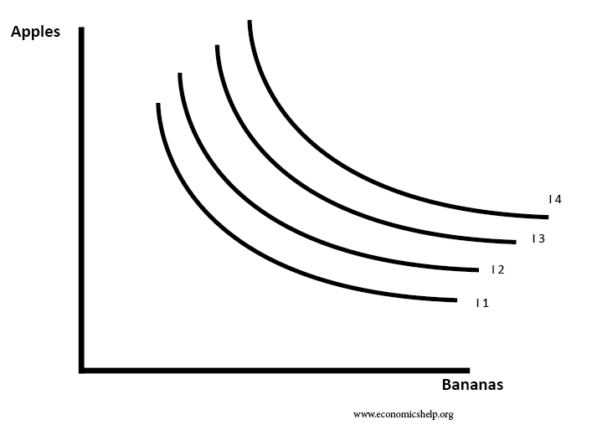
Indifference Map

Slide 89
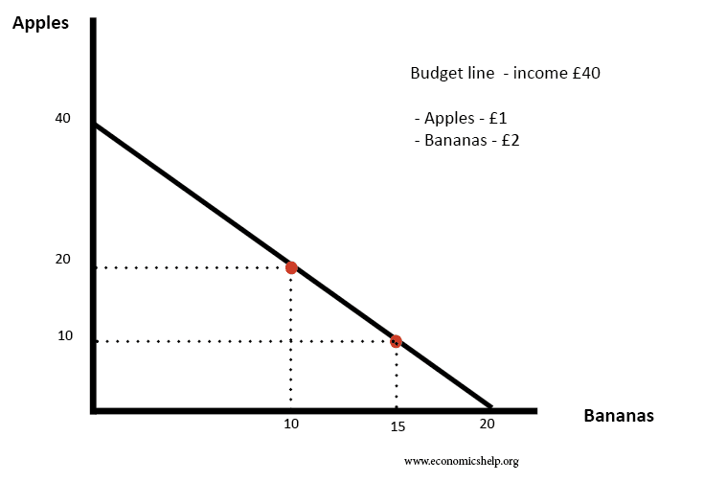
Budget constraint

Slide 90
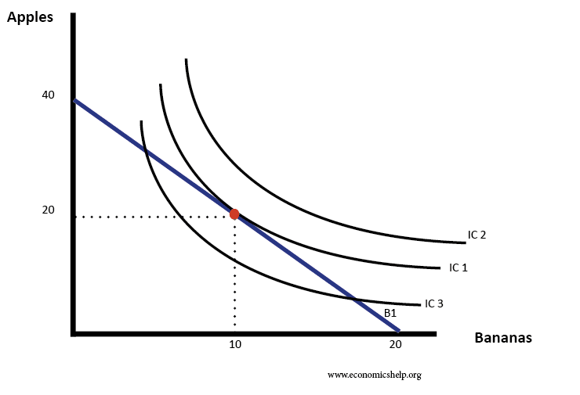
Indifference Map and Budget constraint

Slide 91
Individual Demand Curve
Individual demand curves show the quantity of a good a single consumer is willing to buy at different price levels, while keeping other factors constant.
We derive individual demand curves from utility-maximizing choices by analyzing the combinations of goods that maximize satisfaction within the budget constraint.

Slide 92
Market Demand Curve
Market demand curves represent the total quantity of a good that all consumers in the market are willing to buy at various price levels.
Market demand curves are obtained by horizontally summing the individual demand curves of all consumers in the market.

Slide 93
Application in Value Chain Agriculture
In value chain agriculture, consumer choice theory is applied to analyze the demand for different agricultural products.
Understanding consumer preferences and their response to price changes helps value chain actors make informed production and marketing decisions.

Slide 94
Exercises: Drawing Indifference Curves, Deriving Individual Demand Curve, and Deriving Market Demand

Slide 95
Consider the following utility function for a consumer, where X represents quantity of good X and Y represents quantity of good Y:
Utility function: U(X, Y) = X^{0.5} * Y^{0.5}

Slide 96
Exercise Drawing Indifference Curves
a) Plot the indifference curves for the utility levels U = 1, U = 4, and U = 9 on the same graph.
Derive Individual Demand Curve
The consumer's budget constraint is given by: P_{X} * X + P_{Y} * Y = M,
where: P_{X} is the price of good X,
P_{Y} is the price of good Y,
M is the consumer's income.
Assume P_{X} = 4, P_{Y} = 2, and M = 16.
i) Calculate the consumer's budget line equation.
ii) Plot the budget line on the graph with indifference curves from Part 1.
iii) Determine the optimal bundle (X, Y) that maximizes the consumer's utility, given the budget constraint.

Slide 97
Deriving Market Demand
Suppose there are two consumers in the market with the following utility functions:
Consumer 1: U(X, Y) = X^{0.5} * Y^{0.5}
Consumer 2: U(X, Y) = 2X^{0.5} * Y^{0.5}
The market prices are P_{X} = 4 and P_{Y} = 2, and both consumers have an income of M = 16.
i) Derive the individual demand for good X and good Y for each consumer.
ii) Calculate the total market demand for good X and good Y.

Slide 98
Understanding consumer choice theory and individual and market demand is vital VCA students as it enables them to predict market demand, analyze purchasing behavior, and make informed decisions in the agricultural sector.
By grasping these concepts, students will be better equipped to contribute to the efficiency and sustainability of value chain agriculture.

Slide 99
Lecture 6: The Price System: Price Ceilings and Floors, Taxes, and Subsidies

Slide 100
Understanding these price policies and government interventions is crucial for value-chain agriculture students as they can significantly influence market dynamics and welfare.

Slide 101
Definition of Price Ceilings and Floors
Price Ceiling:
A price ceiling is a maximum price set by the government or regulatory authorities above which a good or service cannot be sold.
It is designed to protect consumers by keeping prices affordable.
Price Floor:
A price floor is a minimum price set by the government or regulatory authorities below which a good or service cannot be sold.
It is intended to support producers by ensuring they receive a certain income level.

Slide 102
Implications of Price Ceilings and Floors in Agricultural Markets
Price Ceilings:
Impact on Consumers: Price ceilings can benefit consumers by making goods more affordable. However, they may lead to shortages if the ceiling is set below the market equilibrium price.
Impact on Producers: Price ceilings can negatively affect producers' profitability if the ceiling is set below the production cost, potentially leading to a decrease in supply.
Market Efficiency: Price ceilings can result in inefficient allocation of resources, as the quantity demanded may exceed the quantity supplied.

Slide 103
Implications of Price Ceilings and Floors in Agricultural Markets
Price Floors:
Impact on Producers: Price floors ensure that producers receive a minimum income, which can be beneficial in the agricultural sector. However, if the floor is set above the market equilibrium price, it may lead to surpluses.
Impact on Consumers: Price floors can lead to higher prices for consumers, potentially reducing consumer welfare.
Market Efficiency: Price floors can also result in inefficient resource allocation, as the quantity supplied may exceed the quantity demanded.

Slide 104
Understanding Taxes and Subsidies
Taxes
Taxes are government-imposed charges on goods and services.
In agriculture, taxes can be levied on agricultural products or inputs.
Subsidies
Subsidies are financial assistance provided by the government to support producers or consumers.
In agriculture, subsidies can be given to farmers to promote production or to consumers to make goods more affordable.

Slide 105
Impact of Taxes and Subsidies on Agricultural Producers and Consumers
Taxes on Producers
Taxes on agricultural producers increase their production costs, leading to a decrease in supply and potentially higher prices for consumers.
Taxes on Consumers
Taxes on agricultural products increase the final price paid by consumers, leading to a decrease in demand
Subsidies to Producers
Subsidies to agricultural producers lower their production costs, leading to an increase in supply and potentially lower prices for consumers.
Subsidies to Consumers
Subsidies to consumers reduce the final price paid by consumers, leading to an increase in demand.

Slide 106
Case Studies on Government Interventions in Value Chain Agriculture

Slide 107
Case Study 1:
Price Ceiling on Essential Agricultural Commodities
Discuss the government's intervention to control prices of essential agricultural products to protect consumers.
Analyze the impact on market equilibrium, supply, and demand.

Slide 108
Case study 2: Price Floor on Agricultural Products
-Discuss the government's intervention to support agricultural producers by setting a price floor on specific crops.
-Examine the implications on producer income, consumer welfare, and market efficiency.

Slide 109
Case study 3: Agricultural Subsidies for Sustainable Farming Practices
-Highlight government initiatives to provide subsidies to farmers adopting sustainable and environmentally friendly farming practices.
-Assess the effects on agricultural production, environmental conservation, and consumer choices.

Slide 110
Exercises: The Price System: Price Ceilings and Floors, Taxes, and Subsidies:
Price Ceiling Analysis: The government imposes a price ceiling of MWK5 per kilogram on tomatoes to ensure affordability. The market equilibrium price is MWK6 per kilogram. Calculate the quantity demanded and supplied at the price ceiling, and determine if there will be a shortage or surplus of tomatoes.
Price Floor Calculation: The government sets a price floor of MWK20 per bushel for wheat to support farmers. The market equilibrium price is MWK18 per bushel. Calculate the quantity demanded and supplied at the price floor, and determine if there will be a surplus or shortage of wheat.

Slide 111
Taxes on Producers: Assume the government levies a MWK2 per unit tax on each sack of potatoes produced by farmers. The market equilibrium price without the tax is MWK12 per sack. Calculate the new equilibrium price with the tax and the effective price received by producers after the tax.
Taxes on Consumers: The government imposes a 10% sales tax on dairy products, which originally cost MWK100. Calculate the final price paid by consumers after the tax is applied.
Agricultural Subsidies: The government provides a subsidy of MWK3 per unit for each box of strawberries sold by farmers. The market equilibrium price without the subsidy is MWK8 per box. Calculate the new equilibrium price with the subsidy and the effective price received by farmers after the subsidy.

Slide 112
Lecture 7: Externalities in Value Chain Agriculture

Slide 113
Understanding externalities is crucial for value chain agriculture students as they play a significant role in market efficiency and resource allocation.

Slide 114
Externalities
Externalities refer to the unintended and uncompensated side effects of economic activities (production and consumption) on third parties/bystanders who are not involved in the transactions.
These effects can either be positive or negative and occur outside the market

Slide 115
Classification of Externalities
Externalities can be classified into two main types:
Positive Externality:
Occurs when an activity creates benefits for third parties who are not directly involved in the activity.
E.g. the use of organic farming practices can improve soil health and benefit neighboring farms.
Negative Externality:
Occurs when an activity imposes costs on third parties who are not directly involved in the activity.
E.g. air pollution from agricultural machinery can harm the health of nearby residents.

Slide 116
Occurrence of Externalities in Agricultural Activities
In agriculture, externalities are prevalent due to the interconnectedness of various production and consumption activities.
Externalities in agriculture include:
Positive Externality: When a beekeeper sets up beehives for honey production, it leads to increased pollination of nearby crops, benefiting neighboring farmers.
Negative Externality: Pesticide use by one farmer may lead to chemical runoff into nearby water sources, affecting the quality of water for other farmers downstream.

Slide 117
Effects of Externalities on Market Efficiency
Externalities can disrupt the efficiency of the market as prices and quantities do not fully account for the external costs or benefits. This leads to:
Underproduction of Positive Externalities: If positive externalities exist, the market may produce less than the socially optimal level of output.
Overproduction of Negative Externalities: If negative externalities exist, the market may produce more than the socially optimal level of output.

Slide 118
Resource Allocation and Externalities
Externalities also affect the allocation of resources in value chain agriculture.
When externalities are present, the private costs and benefits of production or consumption do not reflect the true social costs and benefits.

Slide 119
Policy Options to Internalize Externalities
To address externalities and promote market efficiency, policymakers have several options:
Taxes and Subsidies:
Implementing taxes on activities with negative externalities or providing subsidies for activities with positive externalities can internalize the external effects.
Regulations:
Setting environmental regulations or standards can control the negative externalities, such as emission limits for agricultural machinery.

Slide 120
Case Studies and Exercises
Provide real-life case studies or exercises on externalities in value chain agriculture. Students can analyze the scenarios and identify the type of externality, its impact on market efficiency, and propose policy solutions.
Externalities are an essential aspect of value chain agriculture, influencing market efficiency and resource allocation. Understanding the types and impacts of externalities allows students to develop informed solutions and policies that promote sustainable and efficient agricultural practices

Slide 121
Lecture 8: Producer Choice: Firm and Market Supply

Slide 122
Overview of Producer Behavior
Producers in value-chain agriculture aim to maximize their profits by optimizing production and cost decisions.
Profit maximization involves finding the best combination of inputs to produce the desired output level.

Slide 123
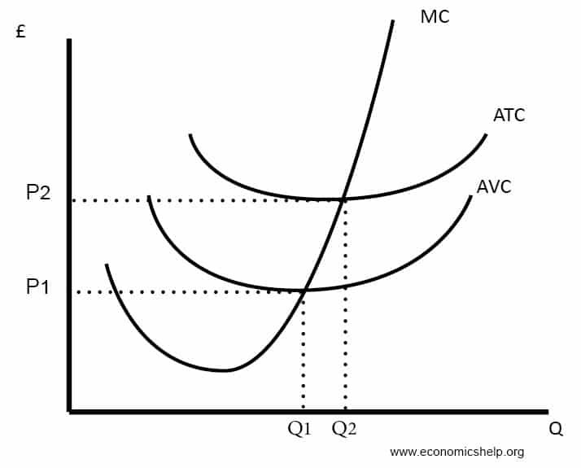
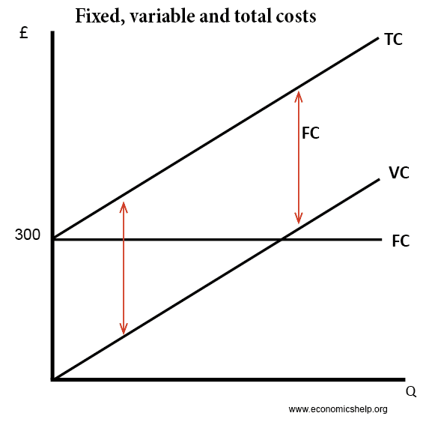
Cost Curves
Cost curves illustrate the relationship between output and cost

Slide 124
Total Revenue (TR) and Total Cost (TC)
Total Revenue (TR) is the total income earned by a firm from selling its products.
It is calculated as the product of the price (P) and the quantity sold (Q): TR = PQ.
Total Cost (TC) is the total expense incurred by a firm to produce a given quantity of output.
It includes fixed costs and variable costs.

Slide 125
Revenue
Revenue curves illustrate the relationship between output and revenue.
Average Revenue (AR), is the revenue per unit of commodity sold. This is the total revenue divided by the output
Marginal Revenue (MR), Marginal revenue is the net addition to the total revenue when one more unit is sold.

Slide 126
Cost Curves
Total Fixed Cost (TFC) – costs independent of output, paying for factory
Marginal cost (MC) – the cost of producing an extra unit of output.
Total variable cost (TVC) = cost involved in producing more units, which in this case is the cost of employing workers.
Average Variable Cost AVC = Total variable cost / quantity produced
Total cost TC = Total variable cost (VC) + total fixed cost (FC)
Average Total Cost ATC = Total cost / quantity

Slide 127
Profit Calculation
Profit (π) is the difference between total revenue and total cost: π = TR - TC.
- Positive profit (π > 0) indicates that the firm is making a profit.
- Negative profit (π < 0) means the firm is facing losses which is also a ‘Loss’

Slide 128
Profit Maximization and Optimization
Producers determine the output level where marginal revenue (MR) equals marginal cost (MC) to maximize profit.
-If MR > MC, increasing output leads to higher profits.
-If MR < MC, reducing output increases profits.

Slide 129
Production Functions
Production functions describe the relationship between inputs and outputs.
In value-chain agriculture, inputs can include labor, land, and capital.
The production function is represented as Q = f(L, K), where Q is the quantity of output, L is labor, and K is capital.

Slide 130
Derivation of Firm and Market Supply Curves
Firm Supply Curve: The firm's supply curve shows the quantity of output a firm is willing to produce and sell at different price levels.
Market Supply Curve: The market supply curve is the horizontal summation of individual firm supply curves.
It shows the total quantity of a good supplied by all producers in the market at various prices.

Slide 131
Relationship with Input and Output Prices
The firm's supply decisions are influenced by input prices (e.g., labor, land, and capital) and output prices (the price at which the firm can sell its product).
If output price increases, firms are motivated to produce more as profit opportunities expand.
If input prices increase, firms may reduce production to control costs.

Slide 132
Exercise 1:
Consider a firm in the value chain agriculture sector that produces strawberries. The production function for strawberries is given as follows: Q = 20√L, where Q is the quantity of strawberries produced and L is the amount of labor input.
Calculate the quantity of strawberries produced when the firm employs 25 units of labor.

Slide 133
Exercise 2:
The total cost (TC) function for the strawberry firm is given by: TC = 5L + 100, where L is the amount of labor input.
Calculate the total cost of producing strawberries when the firm employs 30 units of labor.

Slide 134
Exercise 3:
The price of strawberries is MWK8 per unit, and the firm's total revenue (TR) function is given by: TR = 8Q, where Q is the quantity of strawberries produced.
Calculate the total revenue when the firm produces 50 units of strawberries.

Slide 135
Exercise 4:
Using the information from Exercises 2 and 3, calculate the profit (π) earned by the firm when it employs 30 units of labor and produces 50 units of strawberries.

Slide 136
Exercise 5:
A strawberry producer faces the following cost schedule:
Calculate the firm's average cost (AC) at each quantity level
Calculate the firm's marginal cost (MC) at each quantity level
Quantity (Q) | Total Cost (TC)(MWK)
0 | 50
10 | 120
20 | 190
30 | 260
40 | 330
50 | 400

Slide 137
Case Study: The Tomato Industry in Malawi
The tomato industry in Malawi consists of small-scale farmers who grow tomatoes for both local consumption and export. The market for tomatoes is competitive, with many farmers producing similar quality tomatoes. However, some farmers face higher production costs due to limited access to resources like irrigation and fertilizers.
Analyze the market structure of the tomato industry in Malawi. What are the characteristics of a competitive market, and how do they apply to this industry?
Discuss the factors that influence the supply decisions of tomato farmers. How do input prices and output prices affect their production choices?
How can farmers optimize their profits in the tomato industry? Explain the concept of profit maximization and how it is applied in the context of tomato production.

Slide 138
Lecture 12: Market Structures in Value Chain Agriculture

Slide 139
Market Structures
Market structures refer to the organizational characteristics of a market, including the number of sellers and buyers, the level of product differentiation, and the entry barriers.
Four main market structures exist:
Perfect Competition: A market with many small firms selling homogeneous products and facing no barriers to entry or exit.
Oligopoly: A market dominated by a few large firms selling either homogeneous or differentiated products.
Monopolistic Competition: A market with many firms selling differentiated products.
Monopoly: A market with a single seller and no close substitutes.

Slide 140
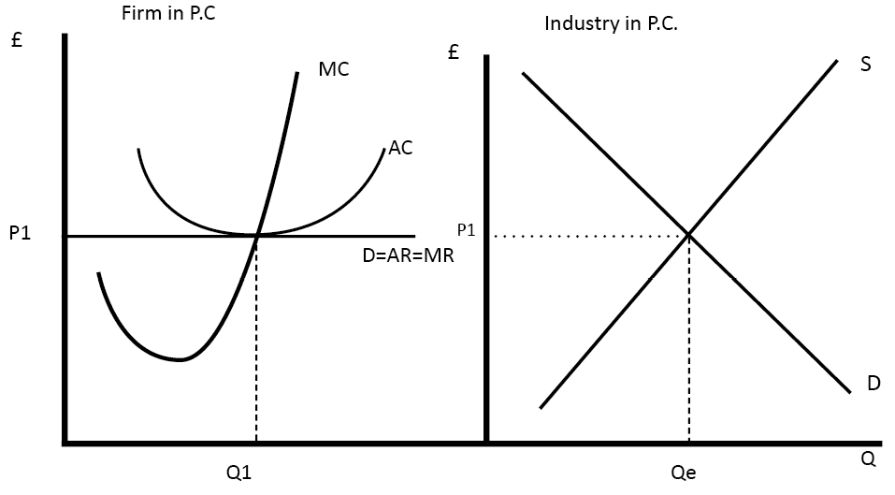
Perfect Competition

Slide 141
Characteristics of Perfect competition
Many small firms
Homogeneous products
No barriers to entry or exit
Price takers (firms accept the market price as given)

Slide 142
Price and Output Determination in Perfect Competition
In perfect competition, firms are price takers, so they cannot influence market price.
The market determines price and output through the interaction of demand and supply.
Individual firms produce at the level where marginal cost equals the market price.

Slide 143
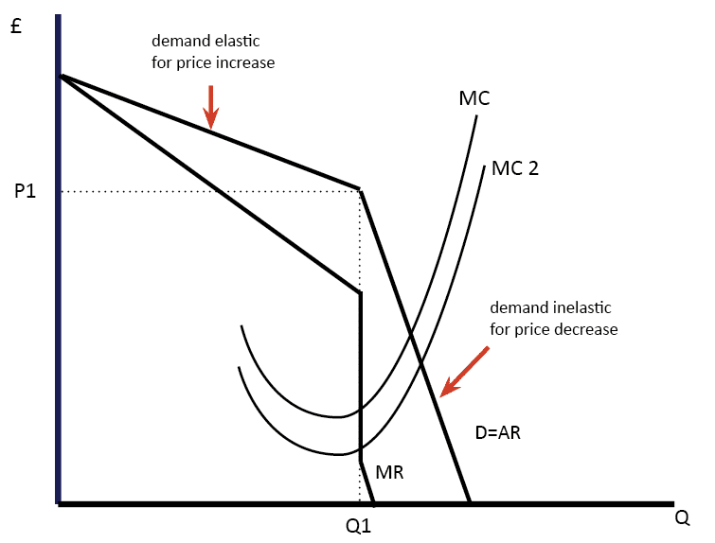
Oligopoly

Slide 144
Characteristics of Oligopoly
Few large firms
Homogeneous or differentiated products
Significant barriers to entry or exit
Mutual interdependence (firms consider rivals' actions)

Slide 145
Price and Output Determination in Oligopoly
In an oligopoly, price and output determination are complex due to interdependence.
Firms may engage in non-price competition (e.g., advertising) and strategic decision-making to gain a competitive advantage.

Slide 146
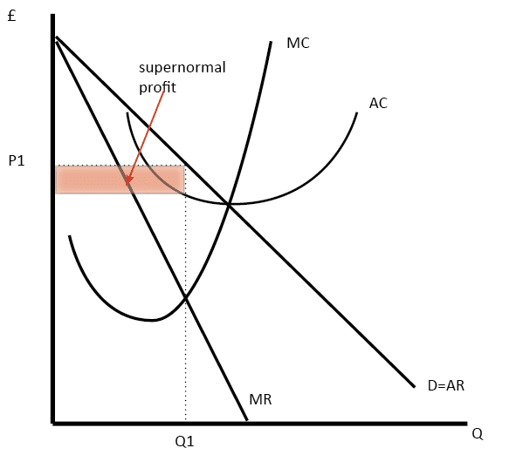
Monopolistic Competition

Slide 147
Characteristics of Monopolistic Competition
Presence of Many firms in the market
Differentiated products
Low barriers to entry or exit
A certain degree of control over product price

Slide 148
Price and Output Determination in Monopolistic Competition
In monopolistic competition, firms have some control over product pricing.
They produce where marginal cost equals marginal revenue but charge a price higher than marginal cost, resulting in excess profits in the short run.

Slide 149
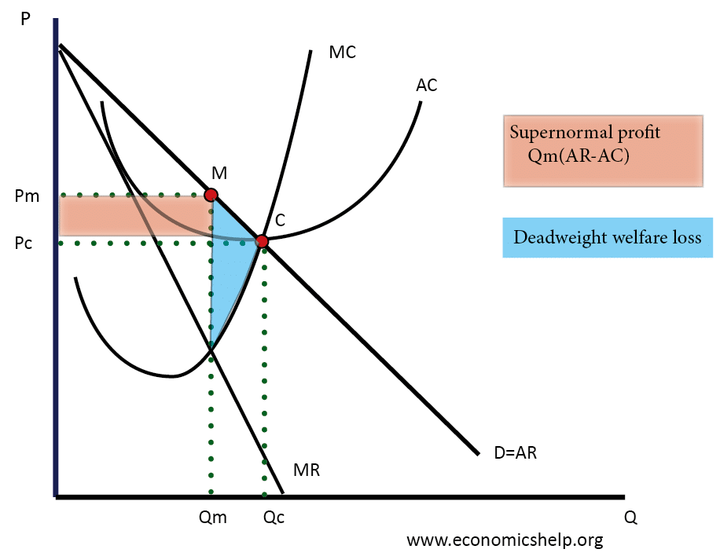
Monopoly

Slide 150
Characteristics of Monopoly
Single seller
No close substitutes
High barriers to entry or exit
Significant market power

Slide 151
Price and Output Determination in Monopoly
In a monopoly, the firm is a price maker, having the power to set the price.
The firm maximizes profits by equating marginal cost to marginal revenue, and the price charged is higher than marginal cost.

Slide 152
Efficiency and Performance Implications of Market Structures
Perfect Competition:
Allocative efficiency: Price is equal to marginal cost(P=MC)
Productive efficiency: Firms produce at the minimum average cost(Lowest point on the AC curve)
Oligopoly and Monopolistic Competition:
Less allocative and productive efficiency compared to perfect competition.
Monopoly:
Lower output and higher price compared to perfect competition.
Lower overall welfare due to deadweight loss.

Slide 153
Welfare Economics
Welfare economics is a branch of economics that focuses on the study of how the allocation of resources and the distribution of goods and services affect the well-being and welfare of individuals and society as a whole.
It aims at analyzing and evaluating the efficiency and equity of economic outcomes and guide policymakers in designing effective and socially beneficial policies.

Slide 154
Welfare Economics
Welfare economics plays a significant role in value chain agriculture by focusing on optimizing resource allocation, improving efficiency, and promoting equitable distribution of benefits throughout the agricultural supply chain.
This branch of economics evaluates the impact of value chain activities on the well-being of stakeholders, including farmers, consumers, and the broader community.

Slide 155
Efficiency and Equity in Value Chain Agriculture:
Efficiency
Efficiency refers to maximizing output with minimal input, achieving higher productivity, reducing waste, and improving resource allocation.
Welfare economics guides stakeholders to identify opportunities for efficiency gains and implement best practices throughout the value chain.
Equity
Equity entails ensuring fair distribution of benefits among different actors e.g. smallholder farmers, laborers, and processors.
Welfare economics assesses income distribution and recommends policies to address disparities and create a more inclusive and equitable value chain.

Slide 156
Externalities and Market Failures:
Value chain agriculture may generate positive or negative externalities that affect the broader society.
Positive externalities, such as sustainable farming practices that improve soil health, benefit the community.
Conversely, negative externalities, like environmental pollution from chemical usage, can harm the environment and public health.
Welfare economics identifies externalities and suggests interventions to internalize them in value chain decisions.

Slide 157
Policy Interventions for Social Welfare Maximization:
Welfare economics provides valuable insights into the impact of policy interventions on the well-being of stakeholders.
Policymakers can use cost-benefit analysis to evaluate different agricultural policies, such as subsidies, price controls, and trade regulations, to ensure that they maximize overall social welfare while considering efficiency and equity objectives.

Slide 158
Sustainable Value Chain Management:
Value chain agriculture is closely linked to sustainability and responsible resource management.
Welfare economics helps value chain actors identify practices that promote sustainable agriculture, reduce environmental degradation, and foster long-term economic viability while supporting the welfare of communities.

Slide 159
Examples of Welfare Economics in Value Chain Agriculture
Fair Trade Certification:
Fair trade certification ensures that farmers receive a fair price for their produce, promoting equitable income distribution and social welfare improvement for smallholder farmers
Environmental Conservation Programs:
Programs that incentivize sustainable agricultural practices, such as organic farming or water conservation, aim to balance economic growth with environmental protection, leading to positive externalities for the community.
Market Access Initiatives:
Policies that improve market access for small-scale farmers, such as building infrastructure or providing market information, can enhance efficiency and increase the welfare of rural communities.

Slide 160
Welfare economics is a valuable tool for value chain agriculture students and stakeholders as it fosters a deeper understanding of the interplay between economic decisions, social well-being, and sustainability.
By applying welfare economics principles, value chain agriculture can achieve better resource allocation, inclusive growth, and environmentally sustainable practices, ultimately contributing to the overall welfare and prosperity of communities and society as a whole.

Slide 161
Case Studies and Exercises

Slide 162
Exercise 1: Perfect Competition:
Suppose there are ten firms in a perfectly competitive market, each producing identical widgets. The market demand for widgets is given by Qd = 1000 - 10P, where Qd is the quantity demanded and P is the price. The firms' cost function is given by TC = 50Q, where TC is the total cost and Q is the quantity produced by each firm.
Determine the market price and quantity supplied by each firm in the long run.

Slide 163
Exercise 2: Oligopoly
Consider an oligopoly market with three major firms producing smartphones. The market demand for smartphones is given by Qd = 2000 - 5P, where Qd is the quantity demanded and P is the price. Each firm's cost function is given by TC = 200Q, where TC is the total cost and Q is the quantity produced by each firm.
Determine the Nash equilibrium price and quantity produced by each firm.

Slide 164
Exercise 3: Monopolistic Competition
In a monopolistic competition market, there are six firms producing similar but differentiated products. The market demand for the products is given by Qd = 800 - 2P, where Qd is the quantity demanded and P is the price. Each firm's cost function is given by TC = 100Q, where TC is the total cost and Q is the quantity produced by each firm.
Calculate the price, output, and profit for each firm in the short run.

Slide 165
Exercise 4: Monopoly
Suppose a monopolist faces the market demand Qd = 500 - P, where Qd is the quantity demanded and P is the price. The monopolist's cost function is given by TC = 100Q, where TC is the total cost and Q is the quantity produced.
Determine the profit-maximizing price and quantity produced by the monopolist.

Slide 166
Case Studies:
1. Perfect Competition: Agricultural Commodities Market
In a hypothetical perfect competition market for maize in Malawi, there are numerous small farmers producing and selling maize. Each farmer sells their harvest at the prevailing market price. Analyze how market forces of demand and supply determine the price and quantity of maize sold in the market.
2. Oligopoly: Pesticide Market
The pesticide market in Malawi is dominated by three major firms. Each firm produces a different type of pesticide. Analyze how these firms' pricing decisions and product differentiation strategies impact the market's overall performance and competition.
3. Monopolistic Competition: Fertilizer Market
The fertilizer market in Malawi consists of six firms producing different types of fertilizers. Each firm engages in advertising and branding to differentiate their products. Analyze the implications of product differentiation and the firms' pricing decisions on consumer choices and market outcomes.
4. Monopoly: Seed Market
A single firm holds a monopoly in the seed market in Malawi. Analyze the monopolist's ability to set the price and its impact on consumer welfare and market efficiency. Consider potential regulatory interventions to promote competition and consumer welfare.

Slide 167
Key Concepts in Game Theory:
Players:
Players in value chain agriculture can be individuals, firms, or groups involved in the value chain, each pursuing their own objectives.
Strategies:
Strategies represent the different options or courses of action available to each player in a game. Players choose strategies to maximize their outcomes based on their preferences and beliefs about other players' decisions.
Payoffs:
Payoffs in value chain agriculture refer to the outcomes or rewards associated with different combinations of players' strategies. These payoffs could be profits, market share, or other relevant metrics.

Slide 168
Types of Games:
Cooperative Games:
In cooperative games, players can form coalitions and work together to achieve mutual benefits.
E.g. farmers in a cooperative may collaborate to collectively negotiate better prices with processors, leading to a win-win situation.
Non-Cooperative Games:
Non-cooperative games involve players making decisions independently, without forming alliances or agreements.
Each player seeks to maximize their individual payoff. Value chain agriculture often involves non-cooperative games due to the presence of multiple independent players.

Slide 169
Examples of Game Theory:
Pricing Strategies:
Players in the value chain, such as farmers and processors, may engage in price-setting decisions. Game theory can analyze how price competition or cooperation affects profits and market share
Supply Chain Coordination:
Game theory can help analyze coordination efforts between actors in the supply chain to improve efficiency, reduce costs, and enhance overall value chain performance.
Strategic Alliances:
Players in the value chain may form strategic alliances to leverage each other's strengths. Game theory can evaluate the benefits and risks of such collaborations.
Negotiations and Contracts:
Game theory aids in analyzing negotiations and contracts between different value chain participants to ensure fair terms and prevent opportunistic behavior.

Slide 170
Nash Equilibrium in Value Chain Agriculture
Nash equilibrium is a key concept in game theory.
It represents a situation where no player has an incentive to change their strategy, given the strategies of others.
In value chain agriculture, this equilibrium helps identify stable outcomes where all participants maximize their payoffs based on the actions of others.

Slide 171
Prisoner's Dilemma:
The prisoner's dilemma is a classic game theory example that illustrates how individuals pursuing their self-interest can lead to suboptimal outcomes for all players.
In value chain agriculture, the prisoner's dilemma can arise when players prioritize short-term gains over long-term cooperation, leading to inefficient resource allocation.

Slide 172
Analysis of Competitive and Cooperative Strategies
Game theory allows us to analyze both competitive and cooperative strategies in agricultural markets.
In competitive scenarios, participants aim to maximize their own profits, leading to intense competition and potentially suboptimal outcomes for the entire value chain.
On the other hand, cooperative strategies involve players working together to achieve mutual benefits and enhance overall efficiency in the value chain.

Slide 173
Practical Examples in Value Chain Agriculture
Price Wars among Farmers:
Farmers in a value chain may engage in a price war, trying to undercut each other's prices to gain a larger market share.
This can lead to lower profits for all farmers involved and create instability in the market.
Cooperative Marketing:
Agricultural producers may form cooperatives to jointly market and sell their products, enabling them to negotiate better prices with buyers and reduce marketing costs
Contract Farming:
In contract farming, agribusinesses and farmers enter into agreements where the agribusiness provides inputs and technical support, and the farmers supply the produce.
Game theory can analyze the strategic decisions involved in negotiating these contracts.
Environmental Stewardship:
When farmers collectively adopt sustainable practices to protect the environment and promote long-term productivity, it benefits the entire value chain.

Slide 174
Exercises
1. Consider a scenario where two competing farmers decide whether to adopt a new technology.
Use the concept of Nash equilibrium to determine the stable outcome and discuss the implications for the value chain.
2. Analyze a case study of a cooperative marketing initiative in the Malawian agricultural sector.
Identify the benefits of cooperation and how it contributes to the value chain's overall success.

Slide 175
Lecture 13: Labour Markets and Incentive Structures in Value Chain Agriculture

Slide 176
Labor markets in value chain agriculture refer to the interactions between farmers, agribusinesses, and laborers seeking employment in the agricultural sector.
These markets facilitate the exchange of labor services needed for various stages of the agricultural value chain.
The role of wages in attracting labor: Wages play a crucial role in labor decisions, as potential workers consider the pay before engaging in agricultural activities.
Attractive wages can encourage more laborers to participate in farming, while lower wages may lead to labor shortages.

Slide 177
Factors Affecting Wage Determination in Value Chain Agriculture
Labor supply factors:
The availability of labor in value chain agriculture is influenced by factors such as the size of the rural population, demographics, education levels, and skills of the workforce.
Areas with a larger pool of skilled labor may have more abundant labor supply.
Labor demand factors:
The demand for labor in agriculture is affected by technological advancements, agricultural productivity, and market conditions.
Modern farming techniques and improved productivity may increase the demand for skilled labor in specific segments of the value chain.

Slide 178
Incentive Structures in Value Chain Agriculture
Incentives are rewards or punishments "The carrot or the stick”
Incentives are rewards or benefits designed to motivate agricultural producers and laborers to improve their productivity and performance.

Slide 179
Types of incentives in value chain agriculture:
Incentive structures can be monetary, such as bonuses or profit-sharing arrangements, or non-monetary, such as training opportunities and capacity-building programs.

Slide 180
Lecture 14: Public Goods

Slide 181
Public goods are goods that are non-excludable and non-rivalrous.
Non-excludability means that individuals cannot be excluded from consuming the good, regardless of whether they have paid for it or not.
Non-rivalry means that one person's consumption of the good does not diminish the quantity available for others.
Examples of public goods in value chain agriculture include certain types of agricultural research, knowledge sharing, and information dissemination.

Slide 182
TAXONOMY OF GOODS
 | RIVALROUS | NON-RIVALROUS
EXCLUDABLE | Pure Private Good | Toll Good
NON-EXCLUDABLE | Common good | Pure Public Good

Slide 183
Characteristics of Public Goods
Non-Excludability: Once the good is provided, it is available to all, and individuals cannot be prevented from using it.
Non-Rivalry: Consumption by one individual does not reduce the amount available for others.
Non-Competitiveness: The consumption of one individual does not reduce the benefits available to others.

Slide 184
Challenges in Providing Public Goods in Value Chain Agriculture
Free-Rider Problem:
Since public goods are non-excludable, individuals may be tempted to "free-ride," benefiting from the public good without contributing to its provision.
This behavior can lead to underinvestment in public goods.
Difficulty in Pricing:
Public goods lack a clear market price because they are not traded in the traditional sense.
This makes it challenging to determine the value and allocate resources for their provision.
Financial Constraints:
Funding public goods projects can be a challenge due to limited financial resources and competing priorities in the agricultural sector.

Slide 185
Solutions to Free-Rider Problems through Government Intervention
Government intervention is often necessary to address the free-rider problem and ensure the provision of public goods in value chain agriculture.
Taxation:
Governments can finance public goods through taxation. By collecting taxes from individuals and businesses, the government can pool resources to provide public goods for the entire community.
Subsidies and Grants:
Governments can offer subsidies or grants to encourage private organizations or research institutions to invest in public goods projects related to agriculture.
Public-Private Partnerships (PPPs):
Collaborations between the government and private sector entities can help mobilize resources and expertise for the provision of public goods.

Slide 186
Relevance of Public Goods to Sustainability and Community Development in Agriculture
Knowledge Sharing:
Public goods such as agricultural research and knowledge sharing contribute to sustainable farming practices, leading to improved crop yields and reduced environmental impact.
Information Dissemination:
Public goods that provide valuable information about market trends, weather forecasts, and best practices empower farmers to make informed decisions, leading to better resource management and higher profitability.
Long-Term Benefits:
Investing in public goods may not yield immediate returns, but they can have significant long-term benefits for the agriculture sector, leading to improved food security, economic development, and community well-being.

Slide 187
Exercises and Case Studies
Exercise
Identify three examples of public goods in value chain agriculture and explain why they meet the criteria of non-excludability and non-rivalry.

